Slide 1
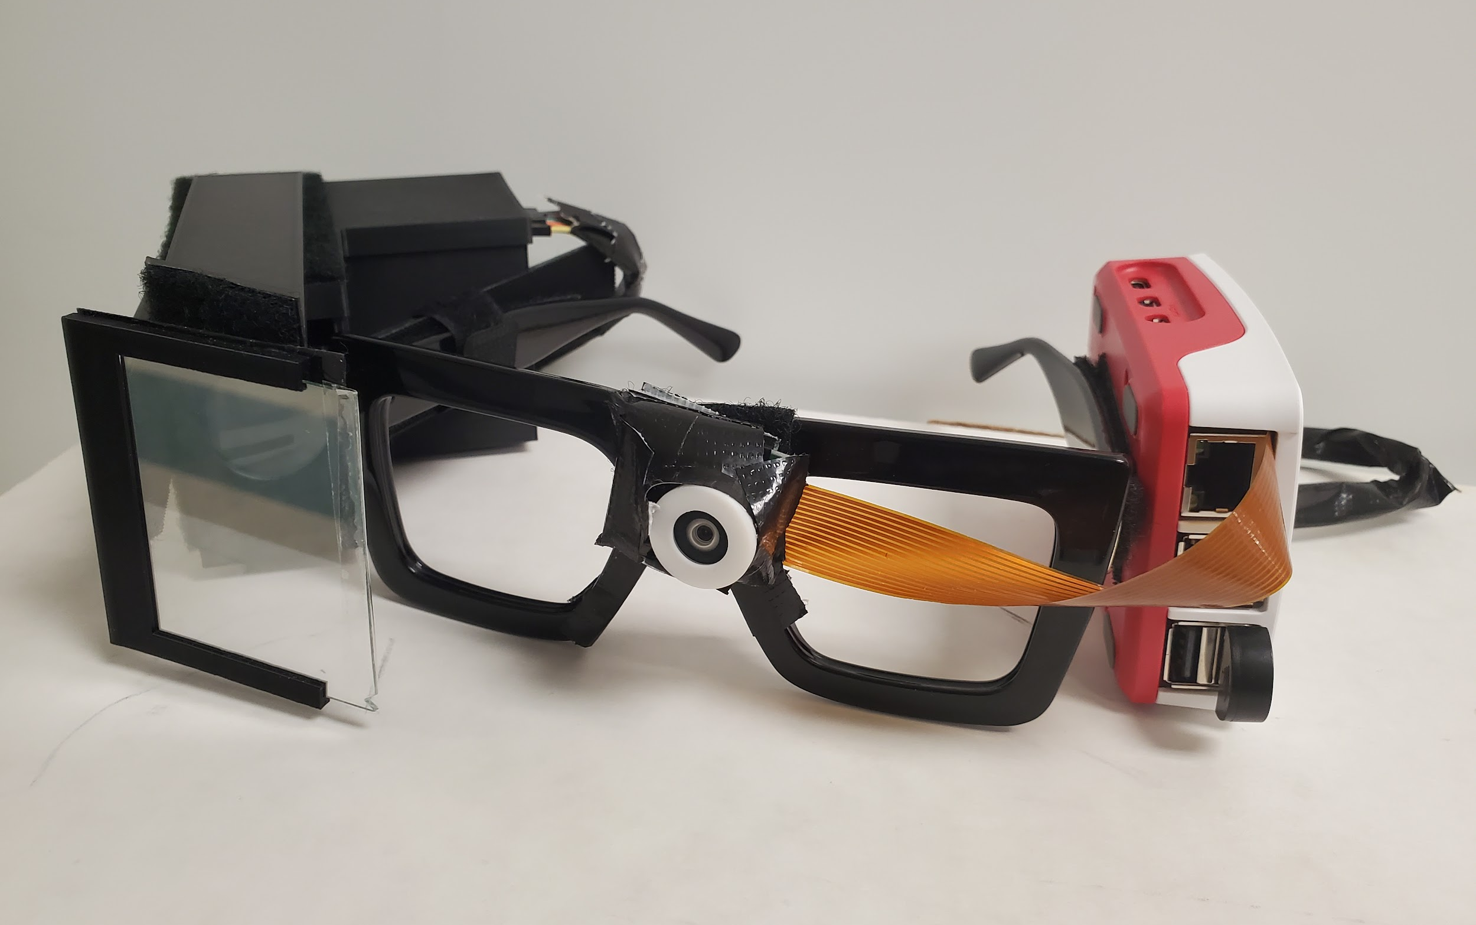
What is IRAS?
Integrated Real-Time Assisted Spectacles (Speech-to-Text and Color Detection AR Glasses)
Working towards improving the quality of life for those with color blindness, hearing issues, and to break language barriers.
Notes:
C

Slide 2
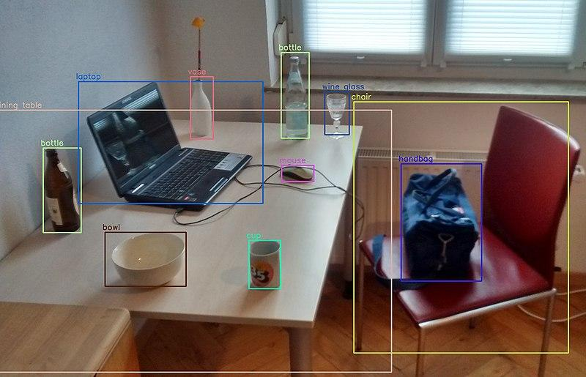
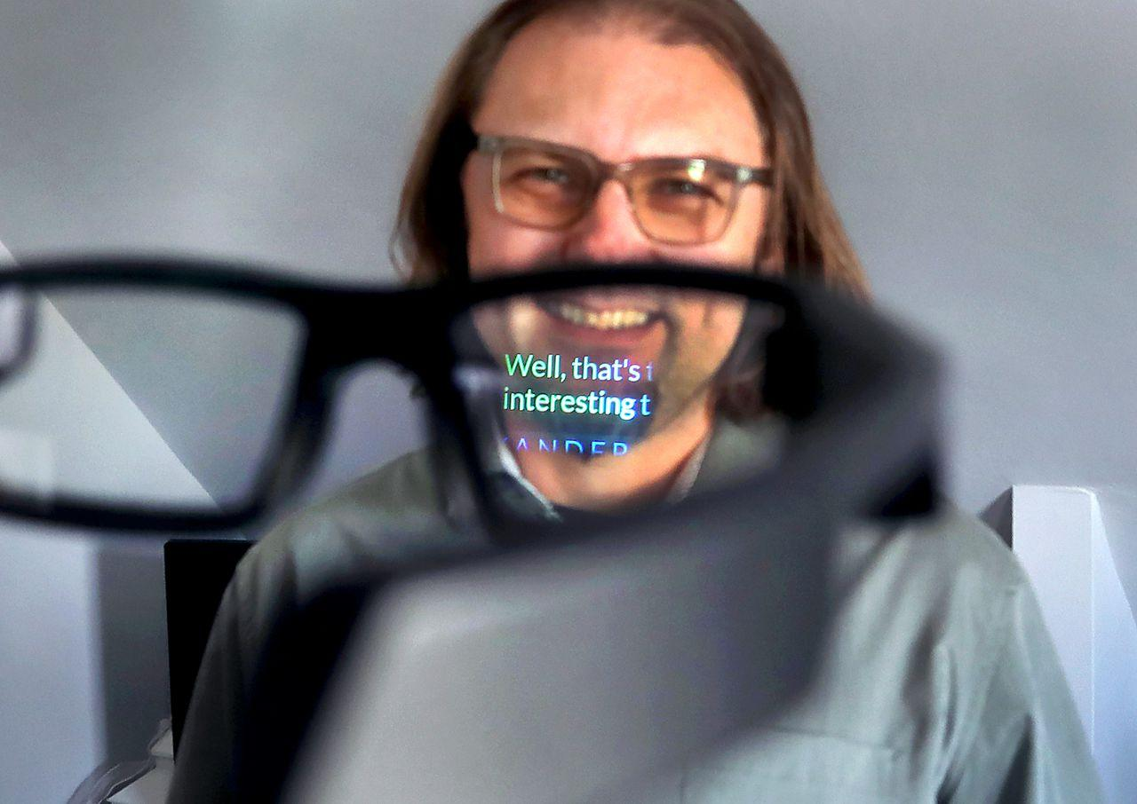
Motivations
Millions of people are affected by hearing impairment and color blindness.
We created a wearable device aimed at helping the deaf, hard of hearing, elderly, and those who struggle with color blindness. This device enhances spoken communication comprehension through captions and translations. It also aids visual perception by using bounding boxes.
Notes:
B

Slide 3
Goals
Optics
Basic
Create the Lens System with desired FOV.
Create LCD Projection design.
Advance
Keep the Lens System minimal with little distortion.
Allow LCD Projection design to be wearable.
Stretch
Allow Lens System to utilize autofocus capabilities.
Simplify the design to minimize the overall size of LCD projection.
Computer Science
Basic
Design an algorithm that utilizes both Speech-to-Text (StT) and Color Detection with Raspberry Pi 5.
Advance
Apply customization to the StT and Color Detection to translate varying languages and colors.
Use an app to control customization and program.
Stretch
Create our own app.
Implement an offline StT mode.
Improve Color Detection under different lighting conditions.
Notes:
D + K

Slide 4
The Engineering Specifications
Components | Parameters | Specifications
Antenna: Raspberry Pi 5 | Transmission Range | 50m-100m
Camera: OV5640 | Capture Quality (Resolution and FOV) | Between 2-5 MP. FOV; ~60 - 80 Degrees
LCD TFT Display | Text and Color Accuracy | >80%
LCF TFT Display | Text and Color Latency | <2s
Frame of Lens Designs | Weight | ~500 grams
Camera Lens System | Widen FOV | ~80 Degrees Horizontally
LCD Projector | Transparency/Visibility | 70% Transparent
Notes:
FIX

Slide 5
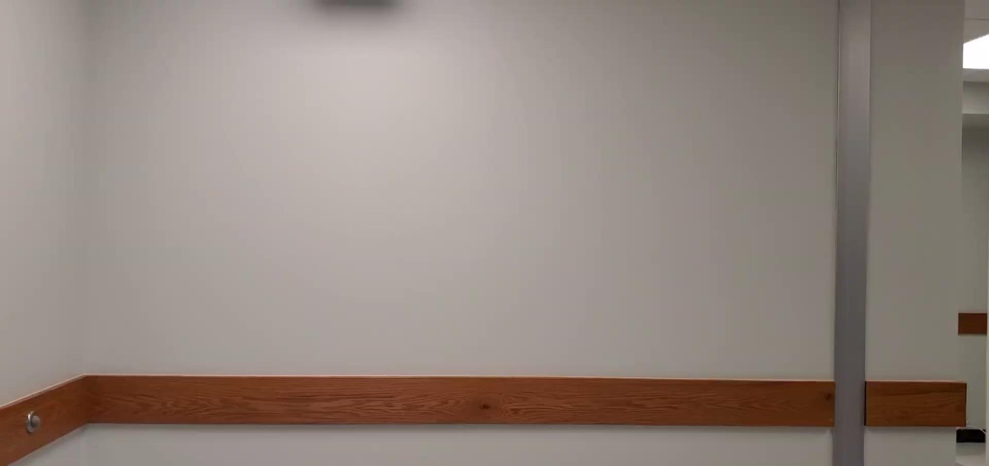
Hardware of Project
Notes:
C

Slide 6
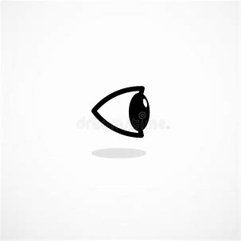
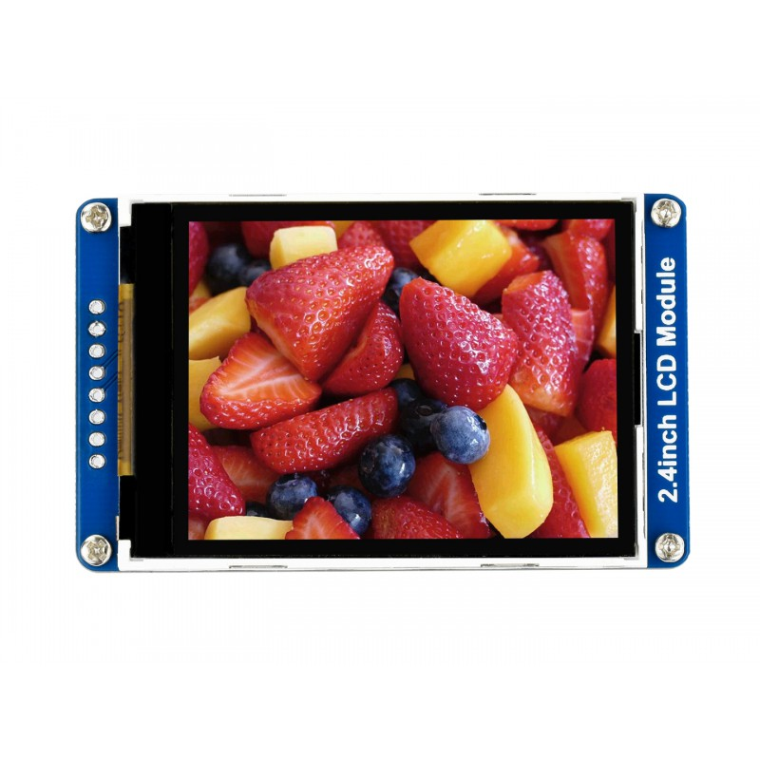
Lens Text Projection Optics Schematics
Components:
LCD TFT
1.69 in Display
400 nits
Plano Concave Lens
Focal Length: -50 mm
Diameter: 25.4 mm
Mirror
Silver Coated
Diameter: 25.4 mm
Plano Convex Lens
Focal Length: 25 mm
Diameter: 25.4 mm
Beamsplitter
Anti-Reflection Coating
70T/30R
40 x 30 x 1 mm
Beamsplitter
LCD
1.5mm
7 mm
Mirror
3.5 mm
Notes:
D
High reflectivity, reduce optical ghosting
Reduces optical loss

Slide 7

LCD Projection Demo
Notes:
State the reasons for each of the components as well as the meaning for the overall set up
Trials and Errors

Slide 8
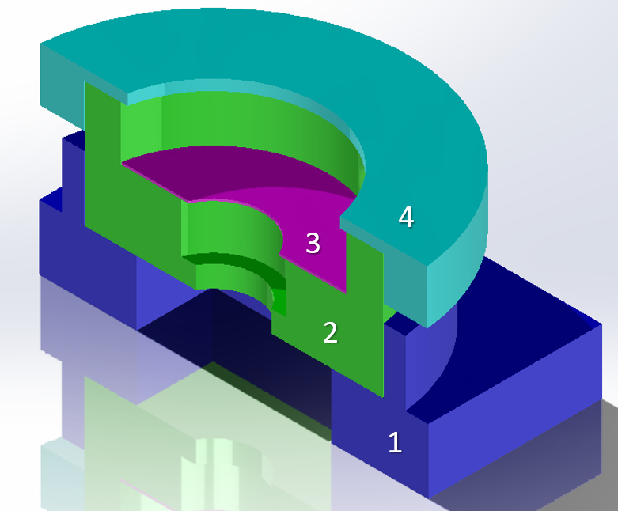
Lens System Design Hardware
10 mm
FL = 17 mm
2 mm
1 mm
2 mm
FL = 10 mm
4 mm
Notes:
C

Slide 9
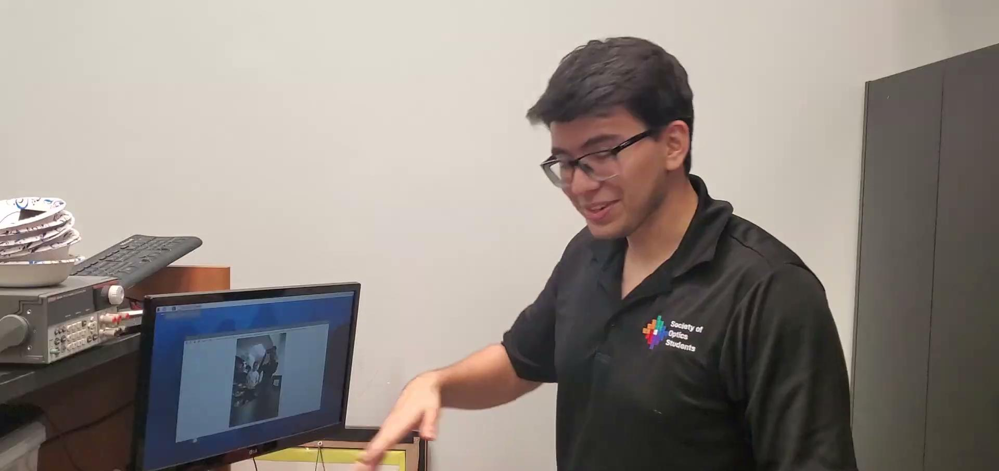
Camera Lens System Demo
Notes:
Include video demonstrating Custom Made lens system
Show the difference between camera’s default view and the added lens system
Reasons for enhancements
Add specifications (60 to 80 FOV)

Slide 10

Live Speech to Text and Color Demo
Notes:
Include video demonstrating Custom Made lens system
Show the difference between camera’s default view and the added lens system
Reasons for enhancements
Add specifications (60 to 80 FOV)

Slide 11
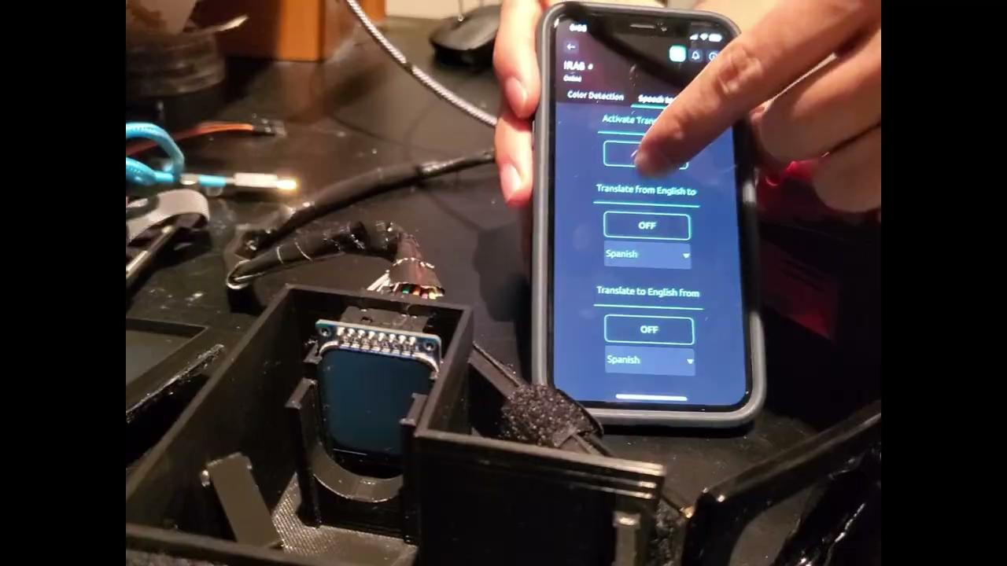
Speech to Text Demo
Notes:
Include video demonstrating Text to Speech on LCD
Reaction time
Accessibility
Customization

Slide 12
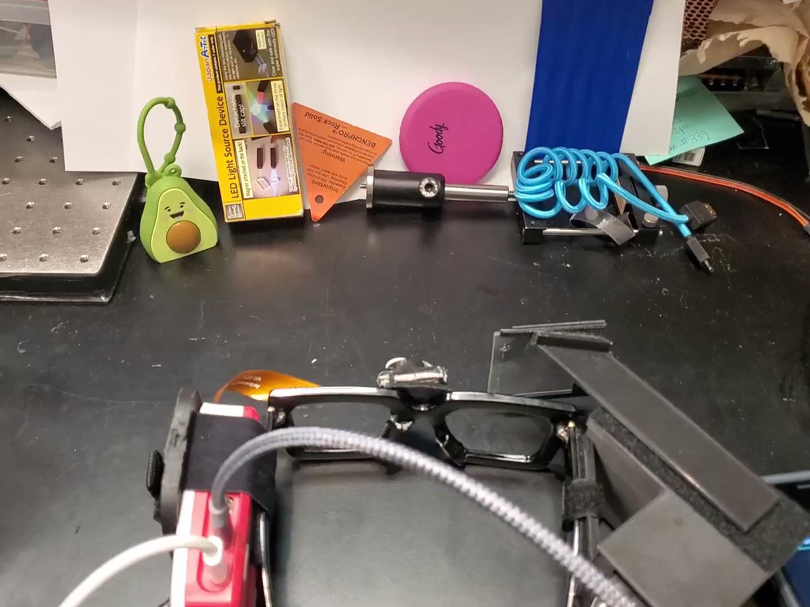
Color Detection Demo
Notes:
Record new color detection video
Include video demonstrating Text to Speech on LCD + Camera
Reaction time
Accessibility (wifi, bluetooth)
Customization (python <- easy, opencv)

Slide 13
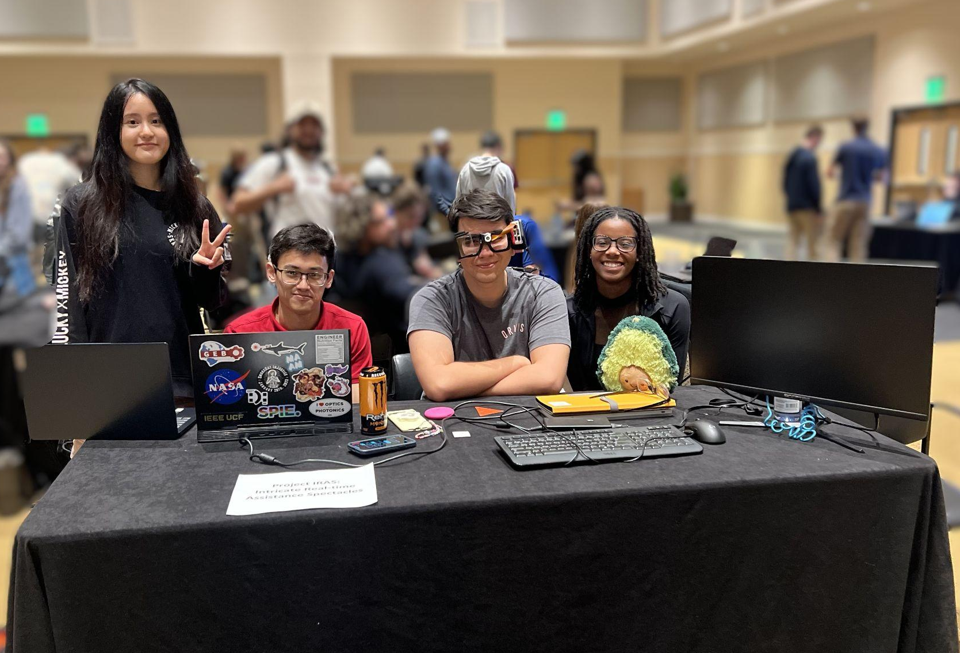
Thanks for Watching! :)

